Slide 1
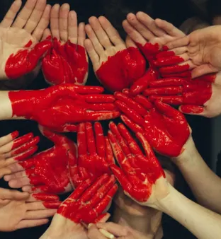
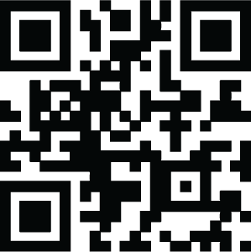

Empathy in Action
Learning to Love
Ourselves and Others
Compassionate Communication
with NVC

Slide 2

Some Ground Rules
1. Create Safety Together 🤝
Connect with curiosity and kindness.
Respect all perspectives, limits, and privacy.
2. Self-Care First 🔋
Listen to your own needs.
If you need a break, take it.
3. Challenge by Choice 🌱
You can always say "Pass."
Stretch your comfort zone, but don't snap it! 🤸‍♂️
Code of Conduct

Slide 3

Disclaimer: Use with Caution 🚧
Side effects of authenticity include:
Awkwardness & Vulnerability 🙈
Getting fired from a job you hated anyway 📉🤷‍♂️
Walking away from relationships that don't serve life 👋💔

Slide 4

Our Communication Approach
Practicing empathy through real conversation
Speak from the Heart: 🗣️ Share your own genuine feelings and needs using "I" statements.
Listen to Connect, Not to Fix: 👂 Our goal is to understand the other person's experience deeply, rather than trying to change it.
Value All Voices: 🌈 Diverse viewpoints are welcomed, encouraged, and celebrated here.
Connection over Perfection! 🧩 It's okay to be messy. We value the intention to connect more than getting the words "right."

Slide 5

Why are We Doing This?
The Energy of Curiosity 🔦✨
We replace judgment with wonder. Curiosity creates the open space where safety, authenticity, and connection can grow.
Permission to be Imperfect 🫣❤️‍🩹 This is a safe space to be messy. We learn more from our authentic stumbles than from "getting it right."
Playground for Growth 🛝 We explore NVC with playfulness and boldness—feeling deeply and learning to love ourselves and others.

Slide 6
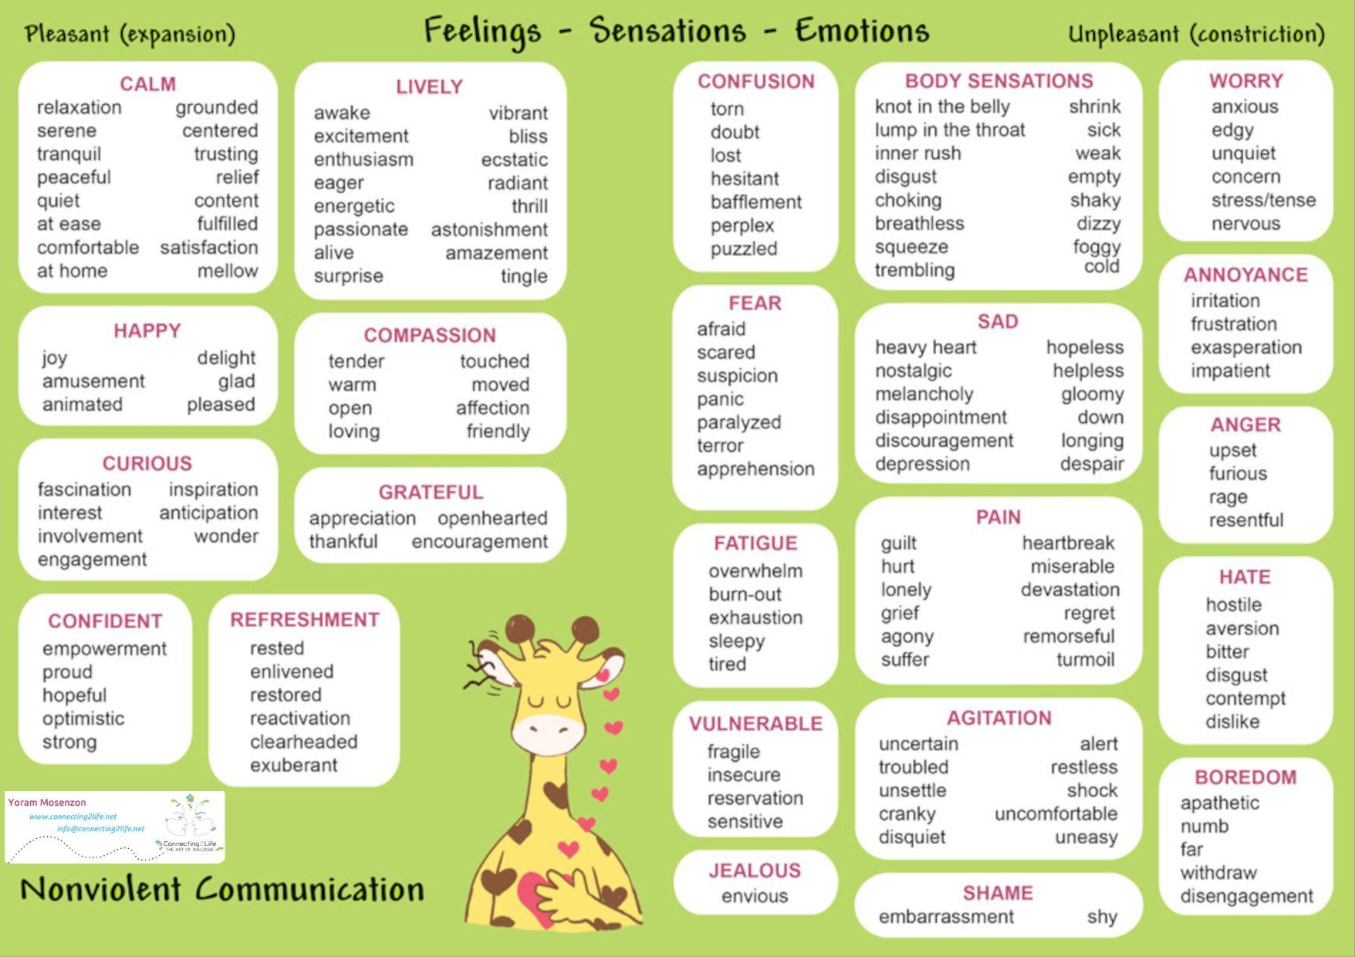

Slide 7
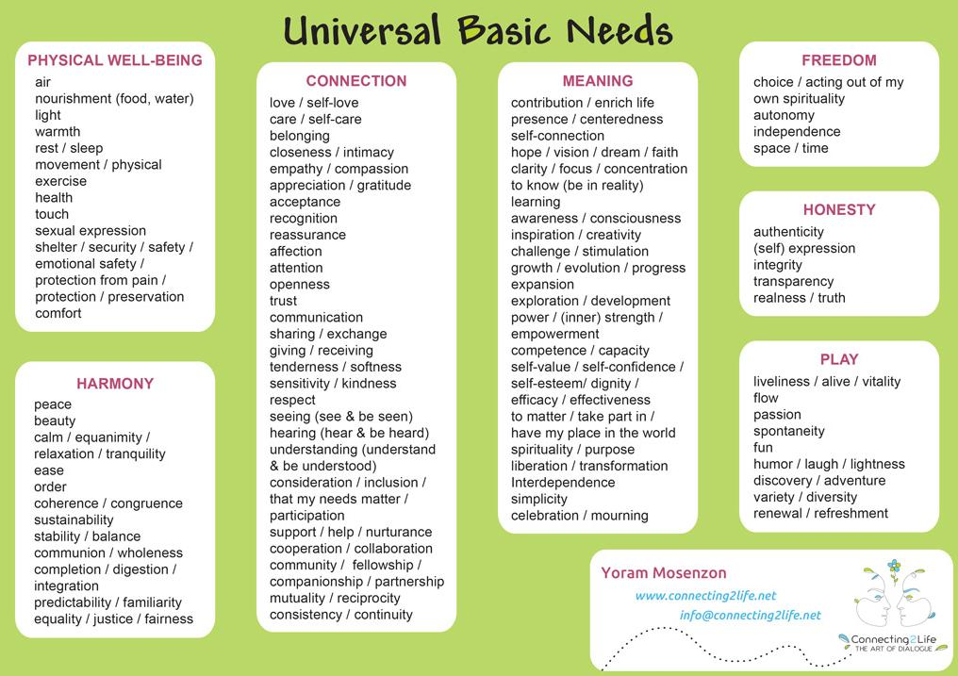

Slide 8
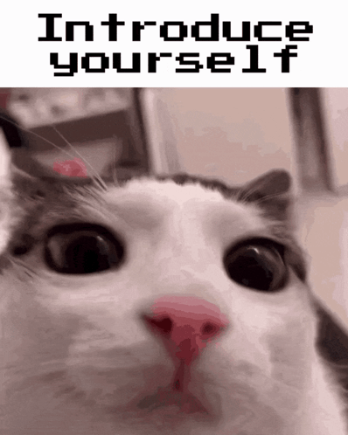
Introductions
Rapid Check-In (~20 seconds/person) ⚡⏱️
Please share:
👋 Name
🌱 Experience: Are you new to NVC?
❤️ Feeling: 1-2 words describing how you feel right now.
🔋 Need: 1-2 words describing a need you have (met or unmet).

Slide 9
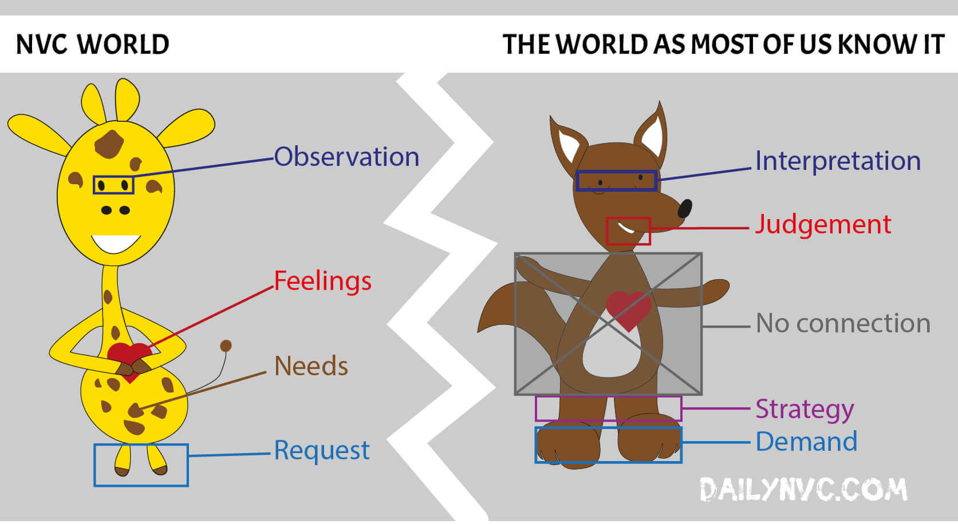
Two Modes, One Human
🦒 The Giraffe (Heart) Because they have the largest heart of any land animal, they symbolize leading with vulnerability, observation, and feelings.
🐺 The Jackal (Habit) Represents our conditioning to interpret, judge, and demand.
The Goal: We don't "kill" the Jackal. We learn to listen to it.
Judgments: Are not "bad"—they are just tragic expressions of unmet needs. We want to remove the shame and punishment, not the signal.
Requests vs. Demands: Humans fundamentally want to help each other.
Demands create resistance;
Requests invite natural giving.

Slide 10


Questions to Help You Discover Who You Are
What are you feeling?
Sad, angry, tired
What do you need?
care/comfort (universal need)
What do you want?
(to satisfy your need?)
You want a hug
What is your request?
“Can you please give me a hug?”
🎉 How do YOU want to live YOUR life? 🎉

Slide 11
The Parts of NVC
Observation
Feeling
Need
Request
Observation involves identifying both internal and external events, while acknowledging personal interpretations and judgments.
A feeling is a sensation in your body that arises from met or unmet needs.
Needs are the conditions human beings require in order to thrive.
A Request is a way to ask for what you want in a way that promotes connection and finding mutually beneficial solutions.
🥺😜🌊

Slide 12
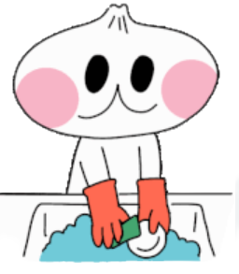

Example of an NVC Request
I feel frustrated when I come home and find dishes in the sink (observation + feeling).
It's important to me to have a tidy space to relax (need).
Would you be willing to load the dishwasher after meals (request)?

Slide 13
Activity

Slide 14
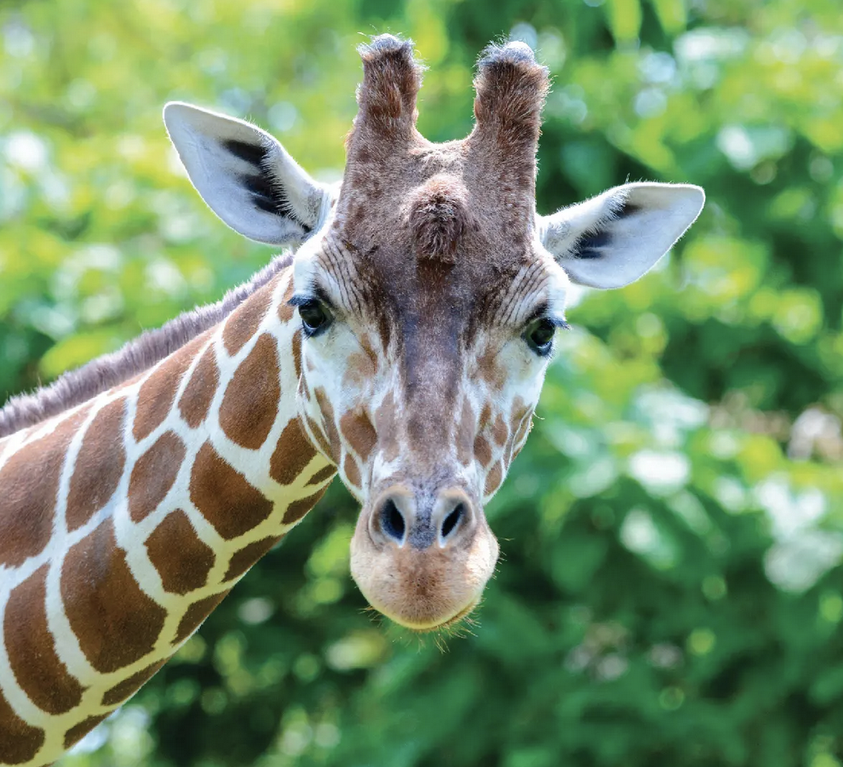

Giraffe Hot Potato (group exercise)
Goal:
To build NVC muscle memory! We are practicing how to quickly identify the 4 steps (Observation, Feelings, Needs, Requests) in real-time.
Skills we are building:
👀 Clear Observation: Separating facts from stories.
❤️ Self-Empathy: connecting our own feelings to needs.
🤔 Curiosity: Getting interested instead of defensive.
🎉 Play: Learning through connection, not perfection.

Slide 15
Giraffe Hot Potato (example)
When I ______ , I feel ______ because I need ______ . Would you ______ ?
🎬 Observation | When I expressed how I felt, you changed the topic; I feel…
❤️ Feelings | scared | curious | angry | frustrated
🔋 Needs | Safety, security | understanding | To be heard | To have space
🗣️ Request | Can we talk about what just happened? | Hey, you seem like your stressed, let’s talk about what you need | Can we talk about what I expressed? | I’m going to take 5 minutes and regroup
Goal: To build NVC muscle memory! We practice identifying the 4 steps (Observation, Feelings, Needs, Requests) in real-time.
How to Play:
The Spark: We start with one Observation (e.g., "I heard a sigh"). 🎬
Fill the Grid: The group calls out any Feeling, Need, or Request that might fit.
  Tip: You can guess for your perspective or the other person's.
The Statement: Finally, we walk through the full sentence together:
  "When I [Observation], I feel [Feeling] because I need [Need]. Would you [Request]?" 🗣️

Slide 16
Giraffe Hot Potato (group exercise)
When I ______ , I feel ______ because I need ______ . Would you ______ ?
🎬 Observation | When I talk to you and you don’t look at me, respond, comment, ask questions, or show visible interest; I feel…
❤️ Feelings | Ignored or angry | Curious/joy | Admiration | Disappointed
🔋 Needs | Attention/connection | Learning | Learning/curiosity/understanding | Acknowledgement
🗣️ Request | Can you hear me, and can you I have 5 minutes of your time? | What’s happening with you right now? I’m curious about you | Tell me what is alive in you? What is going on for you right now? | When I talk to you, can you focus on me when I talk to you?

Slide 17
Giraffe Hot Potato (group exercise)
When I ______ , I feel ______ because I need ______ . Would you ______ ?
🎬 Observation | When I talk to you and you don’t look at me, respond, comment, ask questions, or show visible interest; I feel…
❤️ Feelings | sad | lonely | discouraged | hurt
🔋 Needs | support | connection | presence | care
🗣️ Request | Could you ask me a question about my topic? | Could you respond to me and show me you are listening by reflecting what I have said? | Could you look at me or give me a small response while I’m talking? | Could you pause and tell me one thing you care about in what I’m sharing?

Slide 18
Giraffe Hot Potato (group exercise)
When I ______ , I feel ______ because I need ______ . Would you ______ ?
🎬 Observation
❤️ Feelings
🔋 Needs
🗣️ Request

Slide 19
Giraffe Hot Potato (group exercise)
When I ______ , I feel ______ because I need ______ . Would you ______ ?
🎬 Observation
❤️ Feelings
🔋 Needs
🗣️ Request

Slide 20

Get up and shake it off!

Slide 21

Get up and shake it off!

Slide 22
Activity

Slide 23
The Moment the Story Begins (Canva link)

Slide 24
Get up and shake it off!

Slide 25
Activity

Slide 26
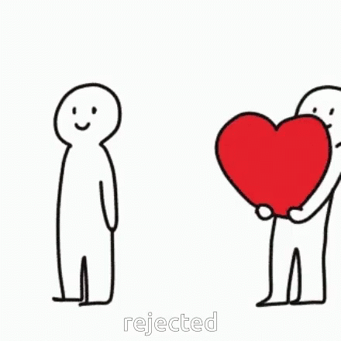
The Art of Hearing "No" 🛡️❤️
The Human Challenge: Rejection feels like a threat to our survival. It is hard to set boundaries (fear of hurting others) and hard to hear them (fear of being hurt).
The NVC Reframe: We practice hearing "No" not as a rejection of us, but as a "Yes" to one of their own needs.
The Trust Paradox: 🤝 If I can trust your No, I can believe your Yes
When we know someone isn't saying "Yes" out of guilt or obligation, their agreement becomes a genuine gift rather than a burden.
Goal: Build Resilience 💪 To hear a "No" without losing the connection or taking it personally.

Slide 27

The Choice of Silence: 😶 You have the choice not to respond at all.
  Note: Every choice has a consequence (a "price" to the connection), but the right to choose is always yours.
The Simple "No": ✋ You can just say "No." You do not owe anyone an explanation or justification. "No" is a complete sentence.
Reflect Back: 🔁 Repeat back what you heard.
  Why: This buys you time to think and ensures you actually understand what they want before you answer.
Empathy Guess: 🦒 Shift the focus to them: "Are you feeling [Feeling] because you need [Need]?" This can diffuse the tension.
The Authentic "Yes": ✅ Say "Yes"—but only if you can do it without resentment.
As the Recipient:
You Have Options 🛠️

Slide 28
Rejection Request Ideas/Scenarios
Could you tell me what you’re really feeling instead of shutting down?
Would you be open to couples counseling?
Can you say ‘I love you’ more often? I miss hearing it.
Would you be willing to forgive me?
Can we try again after what happened?
Can you stay while I cry for a bit?
Would you tell me if something I do pushes you away?
Can I share something personal without you trying to fix it?
Would you be open to hearing how your words landed for me?
Can you be honest with me, even if you think it might hurt?

Slide 29
Rejection Request Ideas/Scenarios
Hey, do you want to hang out tonight? I could really use some company.
Would you like to come over for dinner this weekend?
Could you please do the dishes tonight? I’m really wiped out.
I’ve been sitting on something that hurt me—can we talk about it?
I’m throwing a little birthday thing and would love for you to come.
Would you cuddle with me? I’m feeling very sad from a lack of physical touch…
Would you consider moving in with me? I’d love to share a home with you.
I’ve realized I have feelings for you. I wanted to tell you honestly.
I’m thinking about moving to another city, and I’d love for us to start fresh together. Would you come with me?

Slide 30
Rejection Request Ideas/Scenarios
What the Options Sound Like 🗣️
The Stimulus: Someone asks you: "Can you drop everything and help me right now? I'm freaking out!"
1. The Choice of Silence 😶 (Taking 3 deep breaths to check in with yourself before saying anything. You are choosing not to react immediately.)
2. The Simple "No" ✋ "I am not available to help right now."
3. Reflect Back 🔁 "I hear that you are really stressed and you want me to come over immediately. Is that right?"
4. Empathy Guess 🦒 "Are you feeling overwhelmed? Do you need some reassurance that you can handle this?"
5. The Authentic Response (The "No" with Care) ✅ "I can't come over right now (I have a need for rest), but I would be willing to talk on the phone for 10 minutes."
Facilitation Tip
When you present #2 (The Simple No), remind them: "Notice I didn't say 'I can't because I'm busy.' I just said 'I am not available.' Explanations often sound like excuses. You are allowed to just say No."

Slide 31
Rejection exercise (group exercise)
Would you be willing to lend me your car for the weekend?
Can you help me move my furniture tomorrow?
Will you swap your lunch with me?
Would you mind watching my pet while I’m away?
Can I borrow your phone for an hour?
Would you like to join me for a run at 6 a.m.?
Can you stay late to finish this project with me tonight?
Would you share something personal with the group?
Can you give me a ride to the airport early Saturday morning?
Would you cancel your plans to spend time with me now?
Would you skinny-dip with me right now?
Can I text your ex from your phone tonight?
Would you let me draw on your face with a permanent marker?
Will you reveal your wildest fantasy to the group?
Can you prank-call someone using your real voice?
Would you let me see the last photo on your camera roll?
Can you eat a spoonful of hot sauce in front of everyone?
Will you do a dramatic reading of your last text message exchange?
Would you swap outfits with me for the next hour?
Can you send a flirty DM to a celebrity from your own account?

Slide 32

Debrief
Let’s answer these questions:
How are you feeling now? How do you feel about this exercise?
What is your one main takeaway from the exercise?

Slide 33
Get up and shake it off!

Slide 34

See you next time!
We are eager to learn about how you have integrated Nonviolent Communication (NVC) principles into your daily routines.

